Slide 1
John Wilkins Speaks: A Digitization of the Essay Towards a Real Character, and a Philosophical Language
Aidan Wakely-Mulroney
“On Digital Pasts and Digital Futures,” California State University Long Beach, April 2023

Slide 2

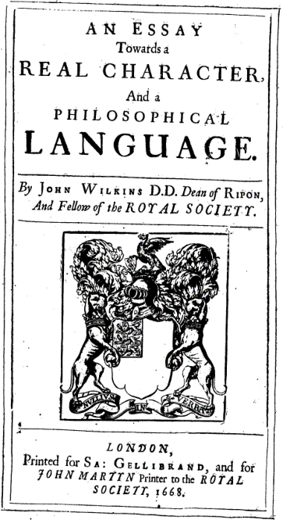
Preparing the Essay
John Wilkins (1614-72)
Dean of Ripon, later Bishop of Chester
Fellow of the Royal Society
Begins his ambitious project ca. 1662
Classification of all knowledge
Development of a new language
Development of new written characters
The Essay finally appears May 4, 1668
But his proposals are not adopted
Notes:
John Wilkins was a fellow of the Royal Society and eventually a bishop
Throughout the early 1660s, he toiled at an ambitious and three-part task
The categorization of all knowledge,
Developing a language that could express this categorization,
And developing written characters to express the language
Almost 355 years ago to today, his language was published
Though his proposals weren’t adopted, we can still learn much from his work

Slide 3
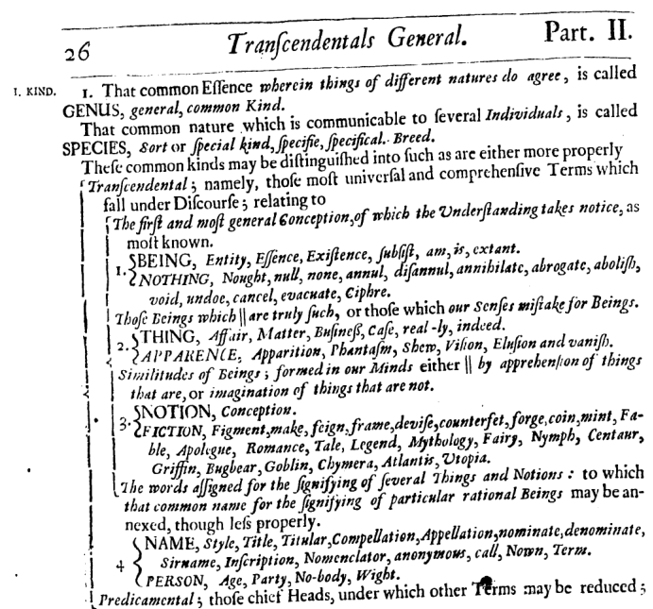
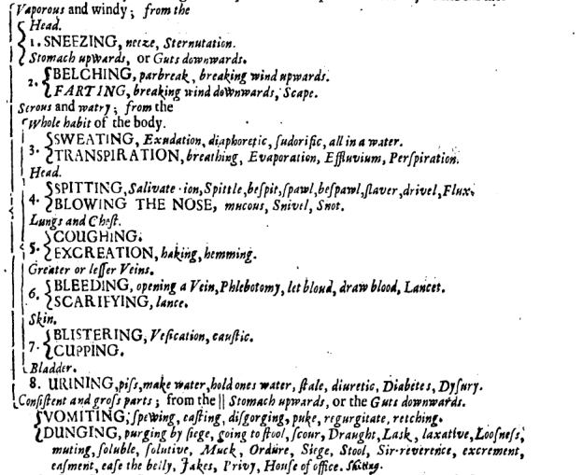
A Text Vast in Scope
From the transcendental…
…to the profane
Notes:
To begin with, the text is vast in scope
Like Hegel, it begins with Being and Nothing
And over 266 pages, it moves into more profane topics

Slide 4
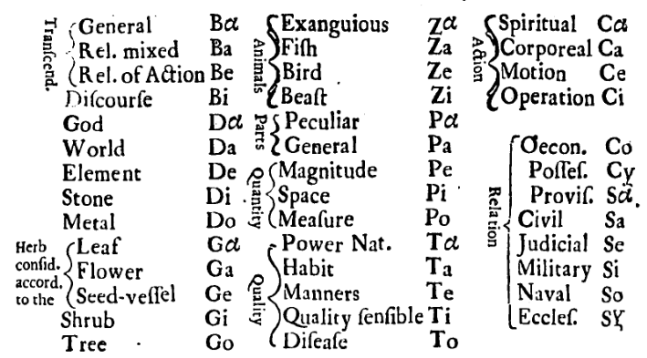
Wilkins’ Categorization Scheme
40 Genera (shown at right)
The top level of organization
250 Differences
2,036 Species
3,823 Radicals
The basic unit of communication
This includes 1,865 “affinities” and “opposites” to other terms
+13,000 synonyms
266 pages of entries
Notes:
How does Wilkins categorize this vast amount of information?
In brief, the system uses several tiers of categorization
At the top are 40 genera, into which Wilkins classes all knowledge
They are listed at the right
He begins with transcendentals down to specific accidents
The genera are divided into differences
These are divided into species
Finally we reach radicals, which are the main units of communication
On top of this, many words (especially radicals) also have paired terms, that Wilkins calls “affinities” and “oppositions”
Affinities are words highly related to the main entry
And opposites may be subdivided into opposites of excess and those of defect
He also provides a large number of synonyms

Slide 5
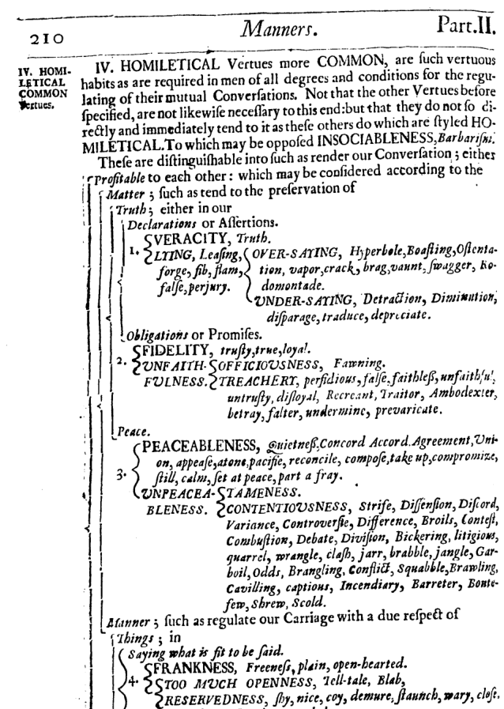
Example of the Tiers
Genus: “Manners”
Difference: #4, “Homiletical Vertues more Common”
And its opposition, “INSOCIABLENESS”
Species: 4 are shown here, only given numbers
Radical: 4 main entries are here, and three paired oppositions (noted in italics); no affinities on this page
In #1, “VERACITY” is a main radical and “LYING” is its opposite; in #2
Double Opposite: 6 here, in brackets beside radicals
#4 is a double opposite; #1-#3 are triple opposites
Synonyms: appear in italics after the main term
For the difference, radical, and double opposites
Notes:
Hopefully this example might help clarify things
Here, we can see a page from the genus “manners”
We have difference #4, “Homiletical Virtues More Common,” listed up top
And the opposition to this also appears, “Unsociableness”
Below this we can see 4 species, and these only have numbers
Then come the radicals, which appear in pairs: first the main entry, then its opposition
On this page, there are no affinities; these appear in the same way as radicals, but they are not italicized
On this page, below the radicals, we see double opposites, showing excesses and defects
This page also shows rare cases of triple opposites, where there are four entries per radical
And finally, the vast majority of words on this page are synonyms

Slide 6
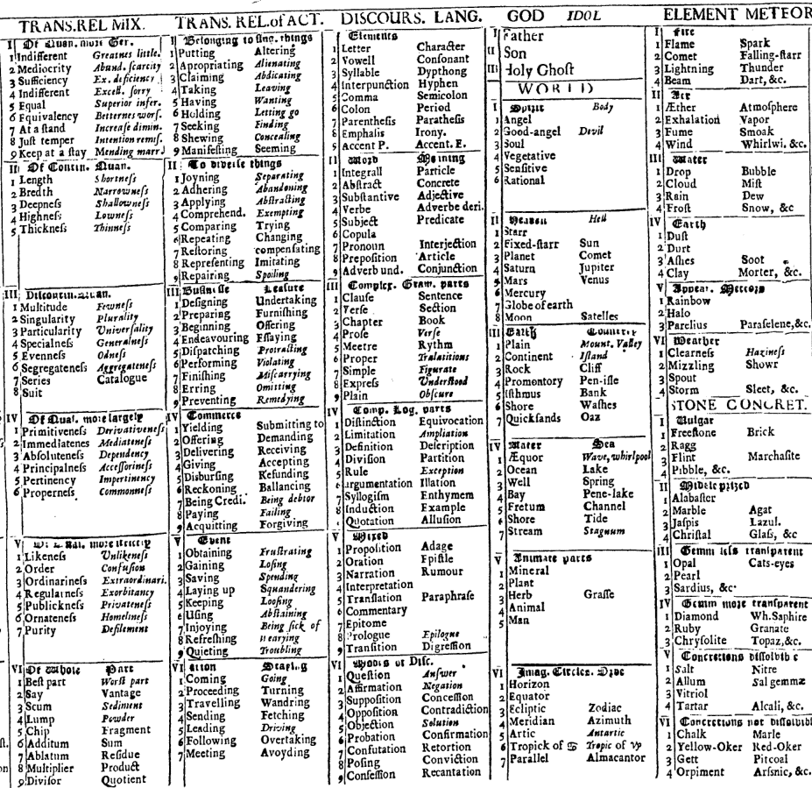
(Part of) The Summary Table
Chapter: not indicated
Genus: column or half column
Difference: blackletter, with Roman numerals at left
Species: Arabic numerals
Radicals: words in regular type
Affinities: appear on right side
Opposites: appear on right side, in italics; double opps. are separated by commas
Synonyms: don’t appear here
Notes:
At the end of the text, Wilkins provides a summary table, which gives a bit more intuitive view of how the categorization works
Genera appear as full or have columns
The columns are divided into boxes of differences, noted by blackletter, with roman numerals
Each line in every difference box is a species, noted by Arabic numerals
And each line splits into one or two radicals: the main entry on the left, and if there is an opposition or affinity, this appears on the right
As you can see, not everything has an opposition
And some differences have more radicals than others

Slide 7
The Language: Latinized Form
Borges on Wilkins:
To each class [i.e., genus] he assigned a monosyllable of two letters; to each difference, a consonant; to each species, a vowel.
For example: de, means element; deb, the first of the elements, fire; deba, a portion of the element of fire, a flame.
Borges’ summary is correct, for basic word types
And each letter has a specific sound
Further rules (extra letters and vowels) apply for
Opposition/Affinity
Substantive/Adjective/Adverb
Neutral/Active/Passive
Abstract/Concrete
Singular/Plural
Can differ for genus vs. radical
Total of 36 different forms
The synonyms hint towards these
Notes:
Borges, Jorge Luis. 2000. “John Wilkins' Analytical Language.” In Selected Non-Fictions, by Jorge Luis Borges, translated by Eliot Weinberger, 229-232. New York: Penguin, p. 230.
Wilkins also created a language in which the letters and structure of each words expresses its position in the system, and hence its meaning
Borges famously described how this works:
And if we go back one slide, in the far upper right, we can see the word for “Flame”
Though Borges is right, there are many more additional rules
Overall, I count up to 36 different possible forms for every word
And this explains the many synonyms, which Wilkins says are meant to hint at other senses that a word can have

Slide 8
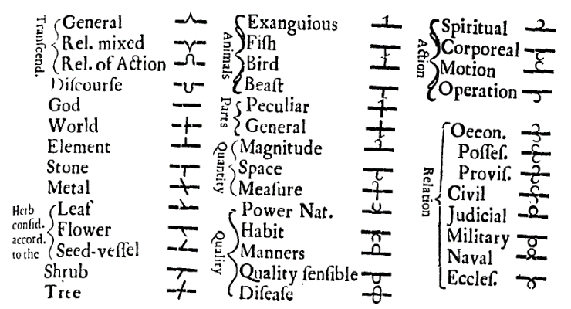
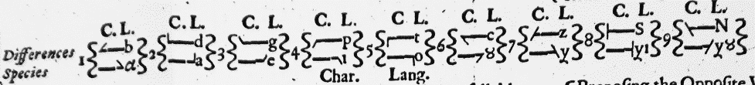
The Characters
Each of the 40 genera has its own unique character (upper box)
Differences and radicals are formed by modifying the left and right ends (lower box)
Opposition, abstraction, passive, etc. are formed by adding hooks and circles to the ends
Notes:
Wilkins’ words can be expressed not only by Latin letters, but by characters
Every character is a modification of one of the 40 genera characters
Difference and radicals tiers are formed by modifying the left and right sides of the base character

Slide 9
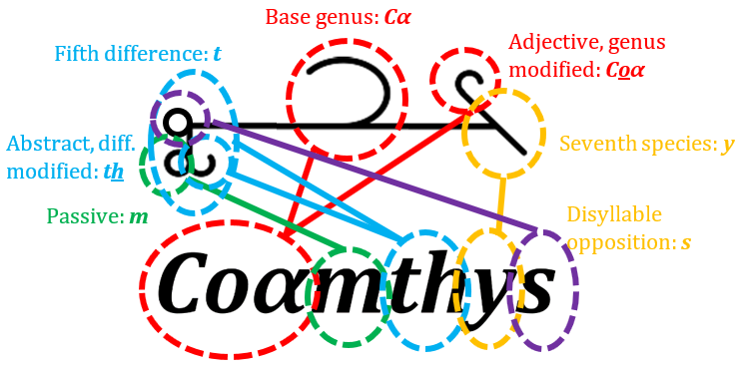
Latin Script vs. Characters
Characters are constructed in a different order than the Latin form
The Latinized words are read linearly (segmented script, like English or Arabic)
Characters are composed of non-sequential morphemes (logographs, like Chinese characters)
At left, the abstract, passive, adjective form of “Diffidence”
Notes:
Here’s an example that illustrates the different ways of writing Wilkins’ words.
These are two versions of “Diffidence”
The many lines here show how a Latinized word is created versus a character.
As you can see, they are built in different orders.
Latinized words can be read left to right
But the characters are not linear. They arguably are built out of morphemes, making them logographs, like Chinese characters, instead of segmented script

Slide 10
The Digitization

Slide 11
Methodology
Goal: a digital version that…
Generates Latinized and character forms for every word
Provides a complete (and error-free) summary table
Is searchable and interactive
Steps
Converting the text into a database (in MS Excel)
Adding in modern spellings, to assist modern users in finding words
E.g., “Economical” for “Oeconomical”
Generating a digital summary table
Coding the language rules
Drawing the elements for characters and coding rules to combine them
Notes:
Moving along, I will now talk about the digital version of the essay
The text seemed to cry out for a way to automatically apply Wilkins’ rules to translate words
I set about transforming the text
As a basis, I used a complete scan of the text provided by the University of Michigan
Using this, I created a database of entries for each word, noting its position in the categorization
I then coded in the rules to build Latinized forms of the word
And finally I drew the components for the characters and coded how they would be strung together

Slide 12
Insights from the Digitization
 | Chapter | Genus | Difference | Species | Radical | Total
Main Entries/ Pairs | (11) | 40 | 250 | (2,036) | 2,036 | 2,326
Unpaired | (11) | 22 | 190 | (2,036) | 249 | 461
Affinity | — | 9 | 38 | — | 1,321 | 1,368
Opposite | — | 9 | 20 | — | 312 | 341
Double Opposite | — | — | 2 | — | 154 | 156
Total Base Entries | — | 58 | 310 | — | 3,823 | 4,191
Synonyms* | — | 243 | 765 | — | 12,067 | 13,075
Total Entries (Original Text) | (11) | 301 | 1,075 | (2,036) | 15,890 | 17,266
Numerical breakdown of word forms
Identification of incomplete grammatical rules
Discovery of publication errors
Errors in species numbering
Errors in sample translations and examples
Many differences between Wilkins’ summary table and the written text
*Division not always clear; others might arrive at slightly different numbers
Notes:
The digitization also gives insights into the text
Such as data on all the various word types
And, in my coding in Wilkins’ rules, I have discovered incomplete ones
It has also revealed errors in the published text
This includes errors in some of Wilkins’ own examples of translations
And there are many differences between the written text and the summary table
To the point that I wonder if the table reflects an earlier version of the system

Slide 13
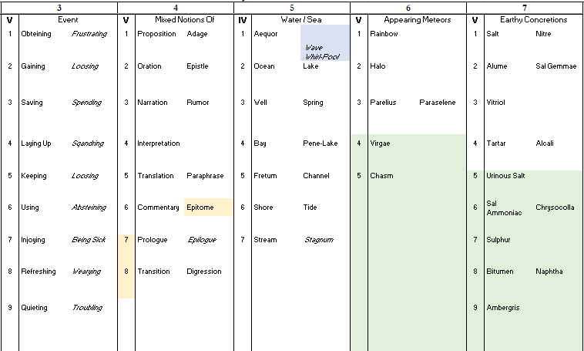
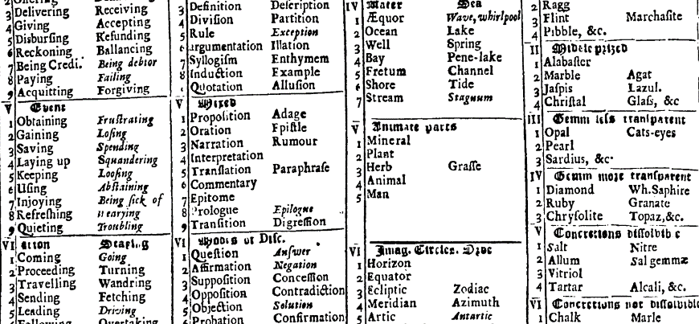
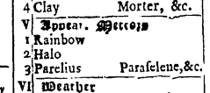
Comparison: Summary Table
The published table
The digital table, noting errors and missing entries
Notes:
Here is a comparison of the published table and the digital version
Because the digital table is pulled from the text, we can use it to find errors in the published table
Here, we can see that “Epitome” is misfiled in the table as a main entry, when the text specifies it is an affinity
The digital table also shows, in green, how many entries Wilkins cut from published table, these are shown in green
These are mostly plant, fish, and bird species

Slide 14
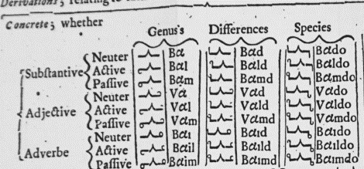
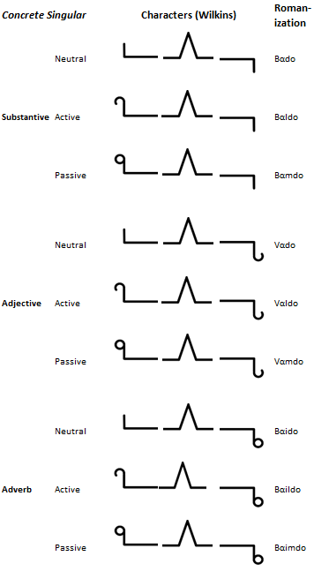
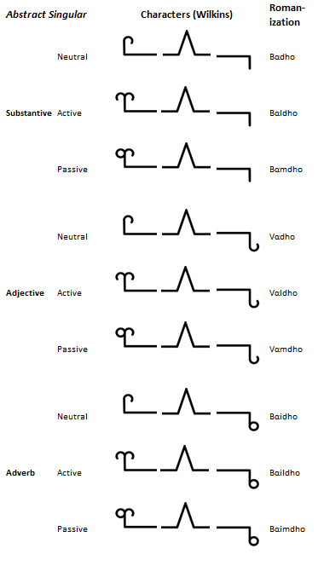
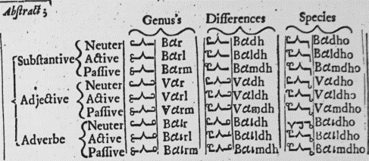

Comparison: Word Forms
Notes:
Here is a comparison of character formation
Sadly, this is the only full example of character formation in the full text
We can also find errors here: as you might be able to see, “Baidho” is misprinted in the original: the first two thirds of the printed character are upside down

Slide 15
Assessment & Questions

Slide 16
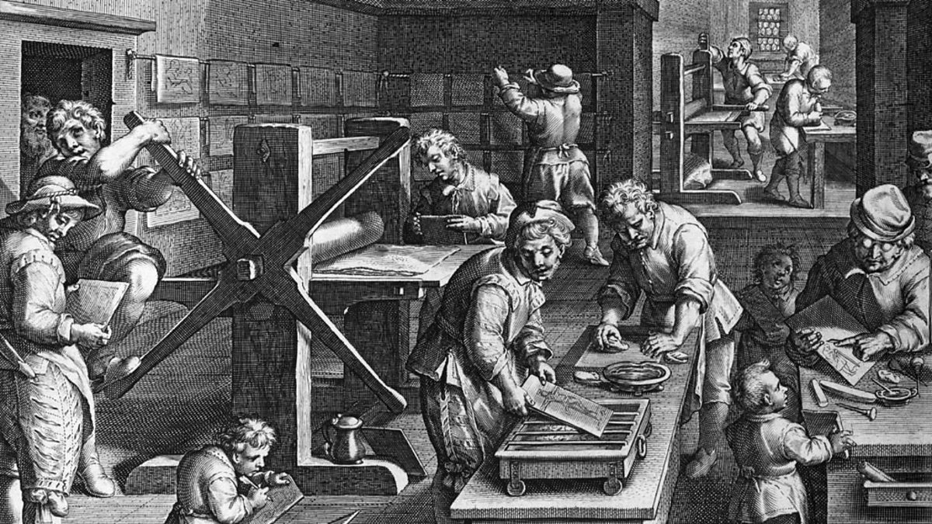
Was Wilkins a Digital Humanist?
Wilkins used advanced technology
The publication of the Essay was only possible thanks to advances in typesetting
Though he lacked a computer, the Essay arguably employs computerized techniques
Regularized and quantified set of data
Elements are manipulated using a specified series of rules and axioms
The system is independent of any currently spoken language
Wilkins is essentially developing a form of analogue code
Notes:
Image source: reproduced by the BBC, https://www.bbc.co.uk/programmes/p003hycj
To conclude today, I’d like to address a few larger questions about Wilkins’ project
My first question is: can we consider Wilkins a digital humanist?
First, he did use advanced technology: publication of the essay was only possible thanks to advances in printing technology
Consider all the characters, the tables, and lines in the original
It’s written almost in a computerized fashion
Wilkins has regularized and quantified a set of data
And he has developed a set of rules and axioms by which this data can be manipulated and expressed
This is essentially the development of an analogue code

Slide 17
Further Reading
Lewis, Rhodri. 2012. “The Essay: Wilkins's "Darling".” In Language, Mind, and Nature: Artificial Languages in England from Bacon to Locke, by Rhodri Lewis, 146-187. Cambridge: Cambridge University Press.
Lewis, Rhodri. 2002. “The Publication of John Wilkins's 'Essay' (1668): Some Contextual Considerations.” Notes and Records of the Royal Society of London 56 (2): 133-146.
Markley, Robert. 1993. “Babel Revers'd.” In Fallen Languages: Crises of Representation in Newtonian England, 1660-1740, by Robert Markley, 63-94. Ithaca: Cornell University Press.
Tillery, Denise. 2005. “Engendering the Language of the New Science: The Subject of John Wilkins's Language Project.” The Eighteenth Century 46 (1): 59-79.
Notes:
I thank you all for your time, and here are some suggestions for further reading on
History
Politics
And gender issues

